Slide 1
EE 66 Lab
Shazam
Welcome! We’ll be starting at Berkeley Time.

Slide 2
Today’s Agenda
What is the Fourier Transform?
DFT Overview
How does Shazam recognize songs?
Marimo Notebook

Slide 3
Semester Outline
Shazam
Acoustic Positioning
Voice
Recognition
Image Deconvolution
Medical Imaging

Slide 4
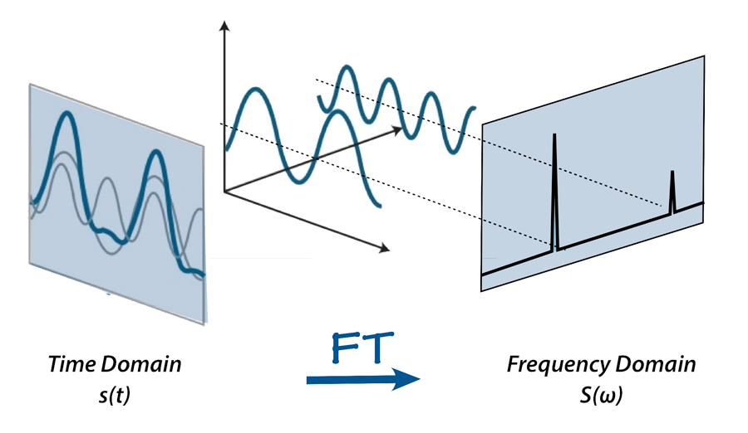
What is the Fourier Transform?
Many interpretations and many uses—but for us, it’s a way to decompose a signal into its frequency components!
This is because we can decompose any arbitrary signal into a combination of sinusoids (sines and cosines).

Slide 5
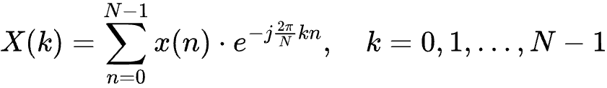
DFT (Discrete Fourier Transform) Cont.
X(k): the Fourier coefficients
x(n): our discrete signal at timestep n
N: number of points in the signal
Let’s break this down!

Slide 6
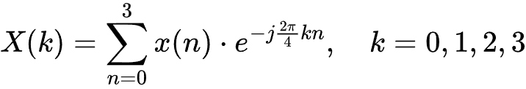

DFT Example (N=4)
For each k, we have the following complex exponentials:

Slide 7


DFT Example (N=4)
Simplifying the fractions, we get this:

Slide 8



DFT Example (N=4)
We can also simplify further by using

Slide 9
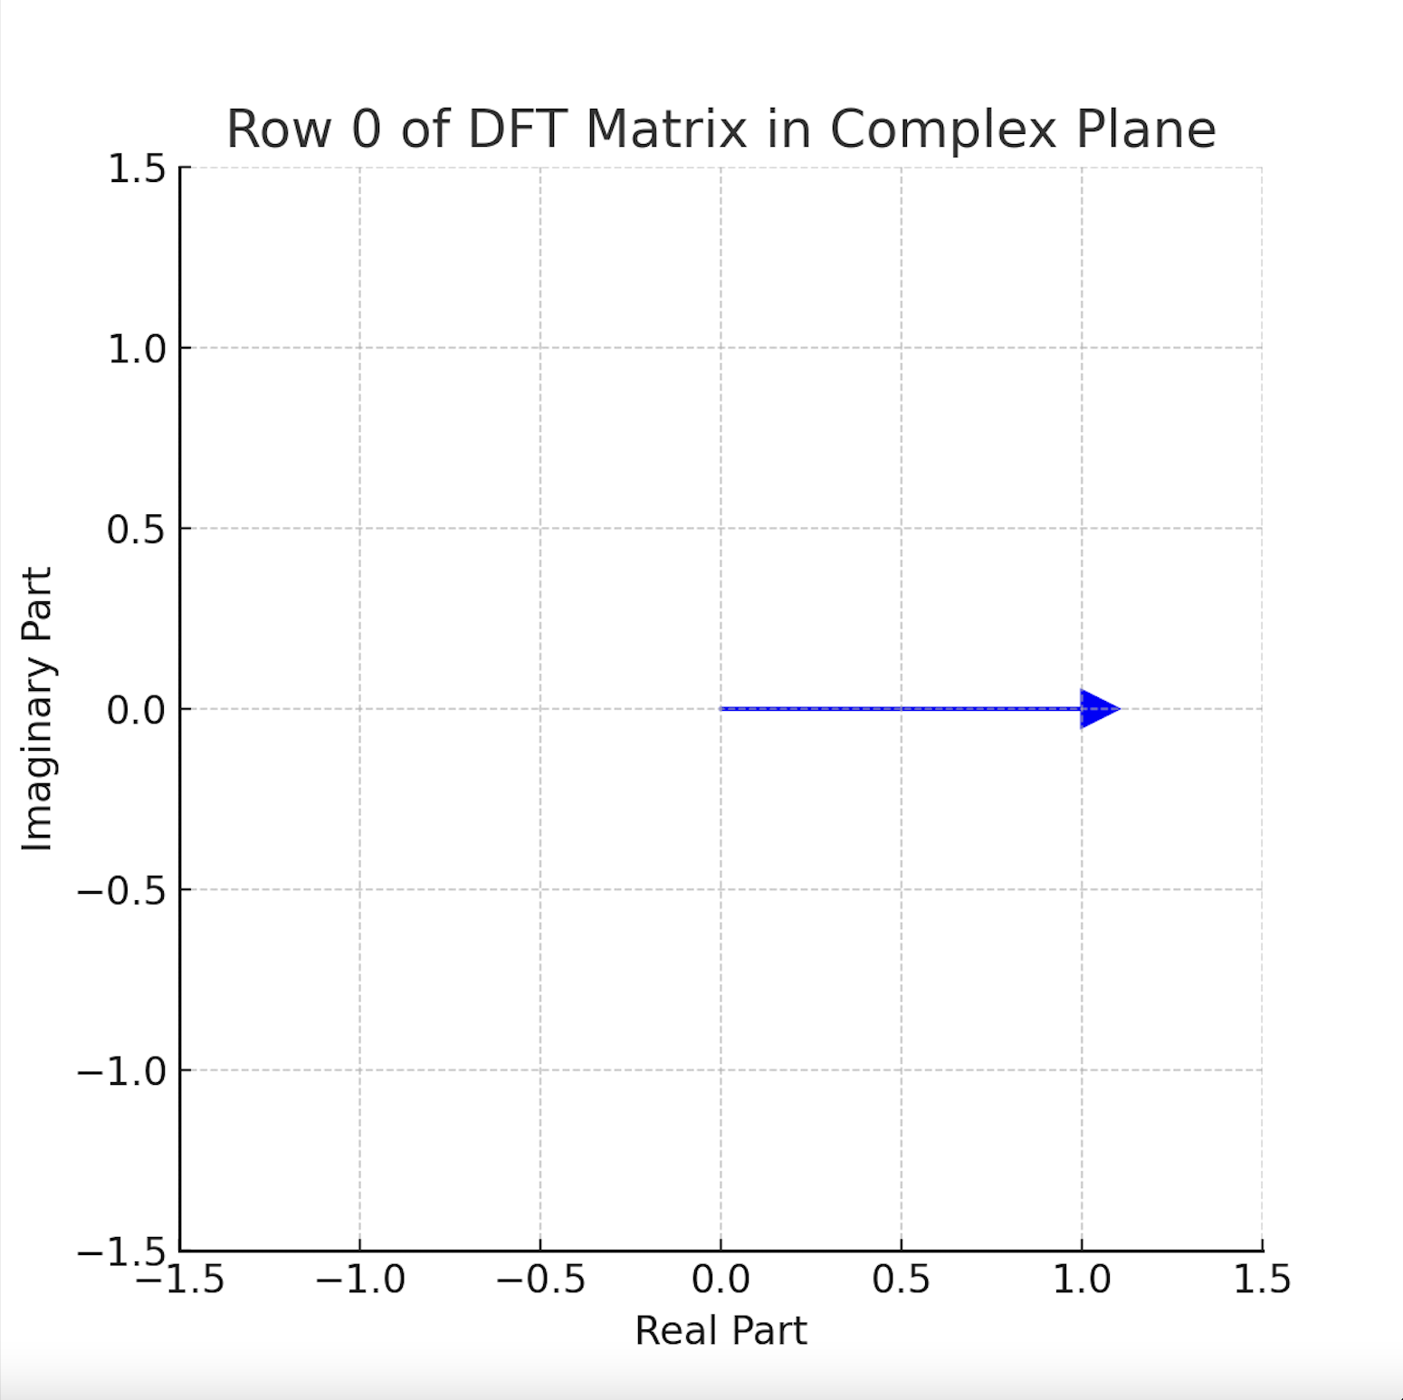
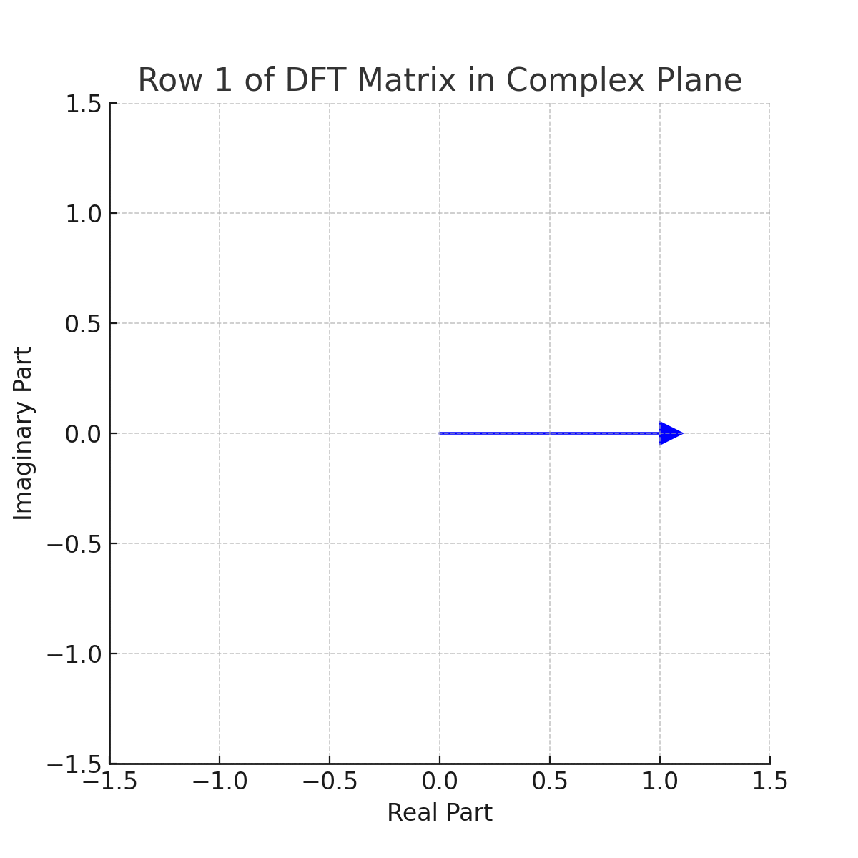


DFT Example (N=4)
What do these vectors look like for each timestep?
We can see that k is our “frequency”.

Slide 10
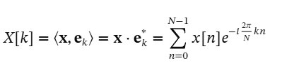
DFT Example (N=4)
Taking a look at the equation, we find that we’re doing a dot product between x, our signal, and each of the four vectors we just derived.

Slide 11




DFT Example (N=4)
Our Fourier coefficients!

Slide 12
What do the Fourier Coefficients Tell Us?
Intuitively, we’re using the dot product to calculate the “similarity” between our signal and the vectors of each frequency.
Thus, we can say that the Fourier coefficients are telling us how much contribution each frequency component has in our signal.
Another way to look at this is that it’s “pulling” out the sinusoidal components in our signal (remember, we said that all signals can be decomposed into combinations of sinusoids.)
Notably, by way of how the DFT is set up, the vector of Fourier coefficients is the same length as our signal.

Slide 13
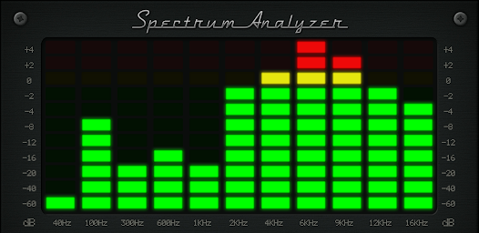
Terminology
We call the vector of Fourier coefficients the “DFT of our signal x.”
We also call the Fourier transform of a signal the “spectrum” of a signal.
e.g.) ever seen these spectrum analyzers / plots for songs? They’re performing the Fourier transform on your songs in real-time.

Slide 14
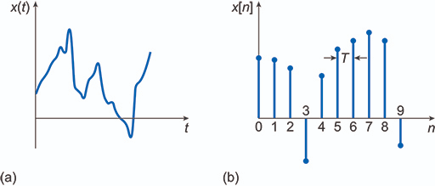
What Makes the DFT “Discrete?”
The data types that we have been working with is discrete, meaning that there are separate values for each discretized timestep.
The DFT is discrete in both the frequency and time domain.

Slide 15
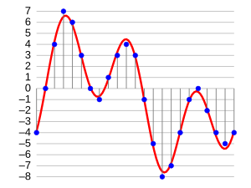
Why is the DFT Useful for Us?
All the data we work with on computers is digital (discrete)
That means the time series data in question can be represented as a 1-d vector, which is what the DFT uses.
  e.g.) mono channel audio data:

Slide 16
What does Shazam do?
“Audio fingerprinting”
  Q: how do we analyze songs so that we can give them a “fingerprint” that is unique to a song?
  A: use spectral analysis! (i.e. analyze the spectrum / DFT of the song)

Slide 17
DFT in Shazam
DFT is a powerful tool here
Problem: there’s zero temporal information
  If you do DFT on the entire song, it gives you the frequency contents of the entire song. It doesn’t tell us about how those contents change throughout the duration of the song.
  e.g.) a song might be more bass-heavy in certain parts of the song.

Slide 18
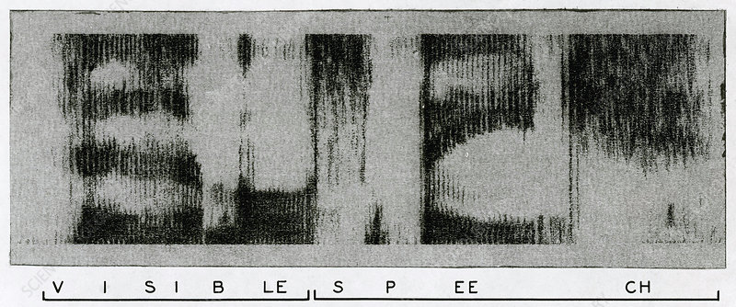
Spectrograms
Many DFTs on short snippets of audio!
Frequency axis (y)
Time axis (x)

Slide 19
Audio Fingerprinting Scheme
We have a spectrogram - a 2D plot that contains values
  Each value tells us the “intensity” of that frequency component at that time
    Coordinates: (time, frequency)
We calculate a threshold value to find the “peaks” in our spectrogram.
We only highlight the peaks in our spectrogram and set everything else to zero.
We turn that image into a value that can be used easily by a computer with a hashing algorithm.
We have an audio fingerprint!

Slide 20
Audio Fingerprinting Scheme
We can run the same fingerprinting algorithm on a snippet of a song we would like to identify.
We can then compare the value we get, and compare it with a pre-existing saved value from all the songs we’ve analyzed, and find a match!

Slide 21
Marimo Notebook

Slide 22
Marimo Notebook
A web-based interactive computational environment similar to Jupyter Notebook
Document containing a list of input/output cells
Can contain code, text, mathematics, plots and rich media
.py file extension
But what does this look like?

Slide 23
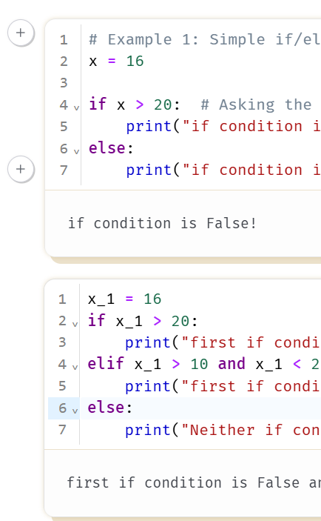
Marimo Notebook
Stateless list of input & output
  The order you run these cells does not matter!
Control/Command + Enter to run current block
Shift + Enter to run and move forward

Slide 24
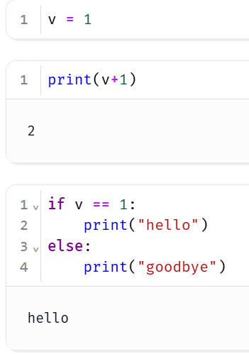
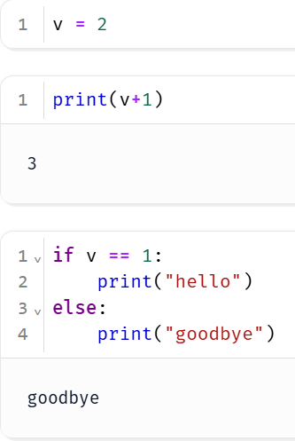
Marimo Notebook
Running / changing one cell executes downstream cells
If I change variable v, the next two cells are automatically affected

Slide 25
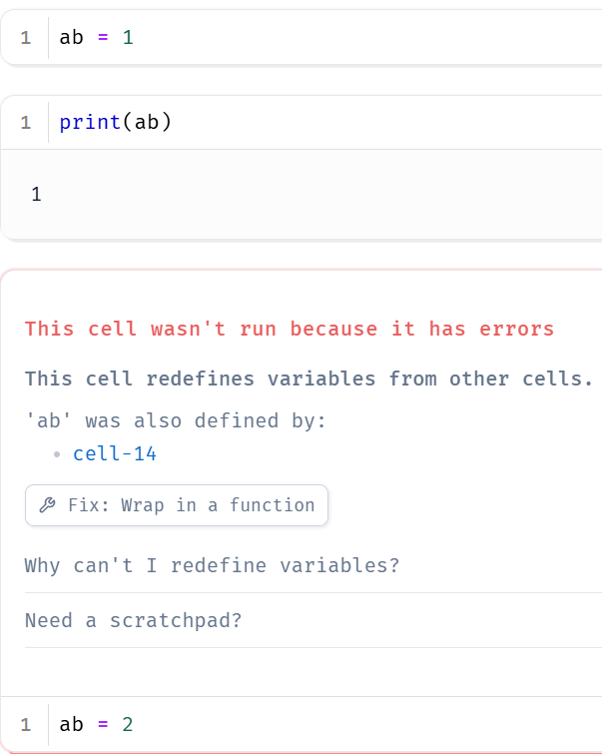
Marimo Notebook
Variable names for assignment can only happen in one cell.
  You cannot define a variable in one cell and redefine it in another cell

Slide 26
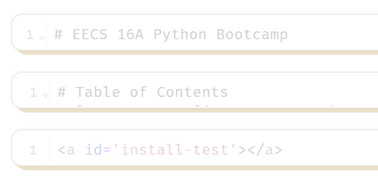
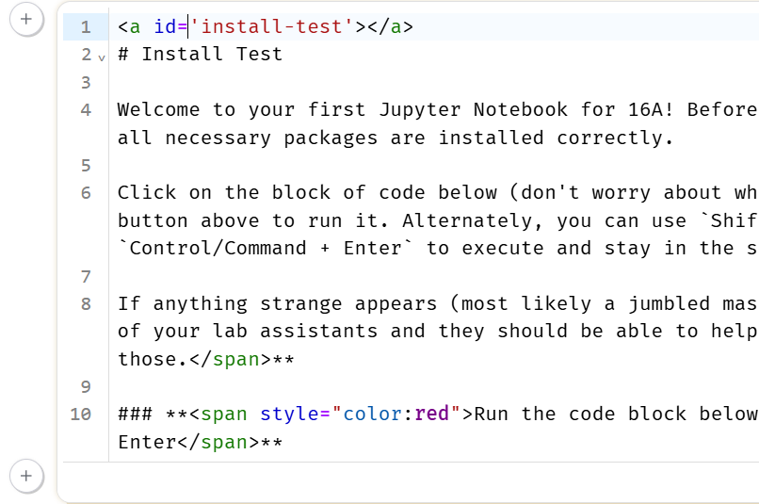
Marimo Notebook
Text/Markdown
Expand on the cell (simply click inside)
Control/Command + Enter to format current block
Shift + Enter to format current block and move forward

Slide 27
Running the Marimo Lab
If you are using the lab computer, login using your CalNet ID
Click on the Datahub link from the course website
You should see a .py file to start working on the lab!

Slide 28
Checking-off Today
Work on Shazam
Pass all autograder checks
Follow the directions linked at bottom of the lab
  Fill out Google form.
  Station number: Sit at a lab computer and enter the number ## on the monitor (c111-##)
During checkoff:
  You will be asked a series of conceptual questions. Make sure you fully understand what is going on.
  If you want to add songs to our playlist: tinyurl.com/66-playlist

Slide 29

Feedback Time
https://tinyurl.com/bdf3ya92

